Slide 1
^{TENAS PROJECT}
Response to Information Request #439
^{from Town of Smithers}
August 11, 2022

Slide 2
OVERVIEW
CONCERNS RAISED OVER:
  How Area Will Look With Coal Mine
  Resultant Dust Fall
PRESENTATION SHOWS HOW OPERATING FACILITIES LOOK IN OTHER COMMUNITIES AND THE LACK OF DUST ON SURROUNDING AREAS:
  Jansen Rail Loadout in Colorado is Similar to Tenas Project Rail Loadout on Bulkley River
  Black Warrior Surface Mine in Alabama is Similar to Tenas Project Mine
  Powhaten Barge Loadout on River is Similar to Tenas Project Rail Loadout on Bulkley River
  Example of What Tenas Access Corridor Road Will Look Like in Winter
  Example of What Mine Infrastructure Complex Will Look Like in Winter
  Examples of Blasting Plumes

Slide 3
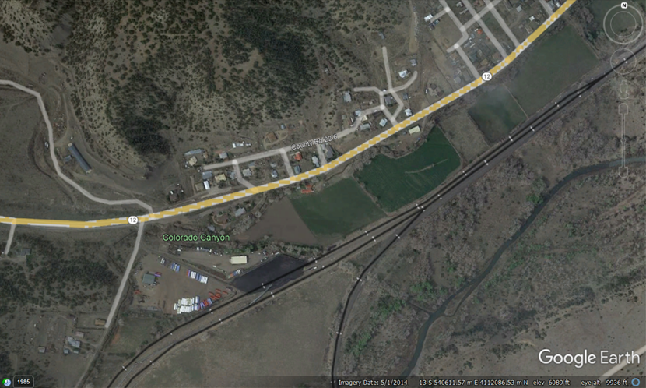
JANSEN LOADOUT, COLORADO
250 meters from Housing Subdivision
1 Train Every 2 Weeks
In Operation Since August 2021

Slide 4
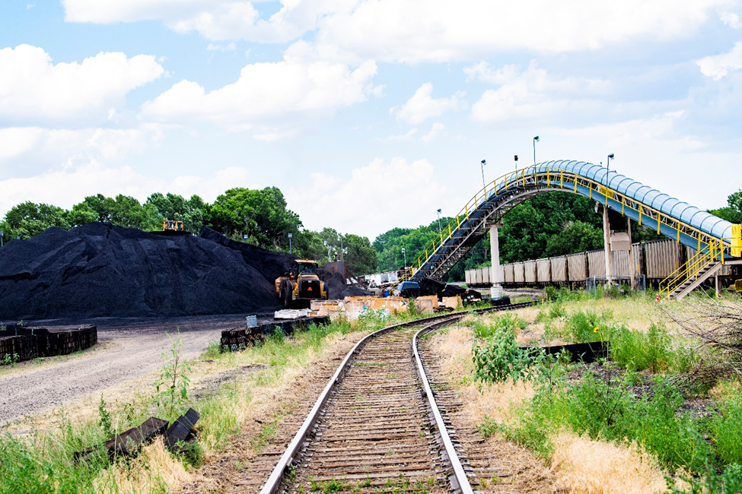
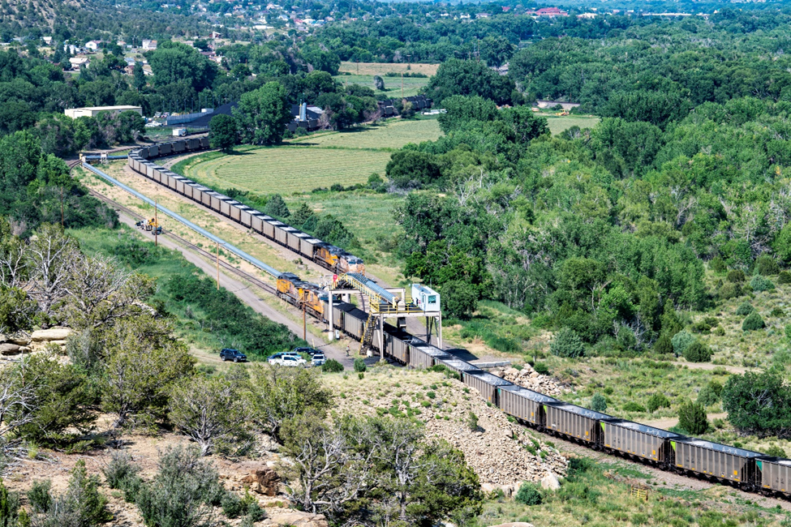
JANSEN LOADOUT, COLORADO
Coal Stockpile and Rail Loadout
Similar to How Tenas Project Will Look,
and Showing Lack of Dust in Surrounding Areas

Slide 5
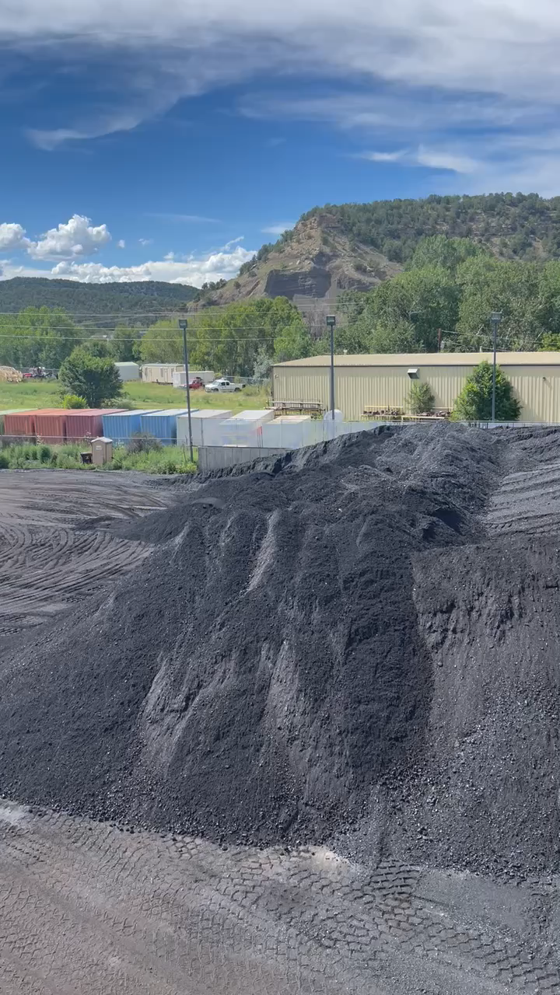
JANSEN LOADOUT, COLORADO - VIDEO
Scroll over image and press PLAY
Video shows panoramic view of
Coal Stockpile at Rail Loadout

Slide 6
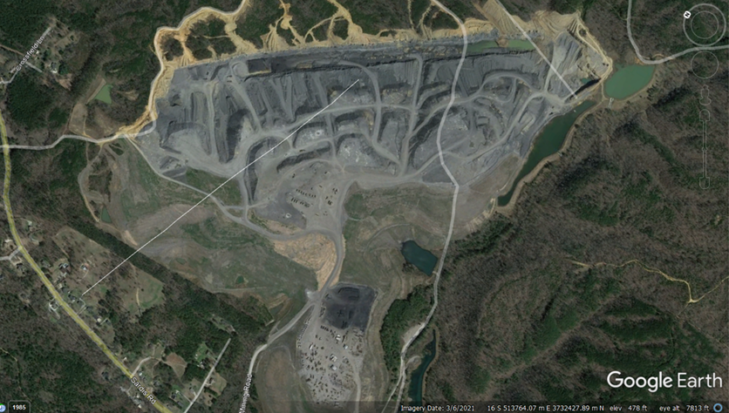
BLACK WARRIOR MINE, ALABAMA
1.5 km from Housing Subdivision
500 K tonnes per year
20 Years In Operation

Slide 7
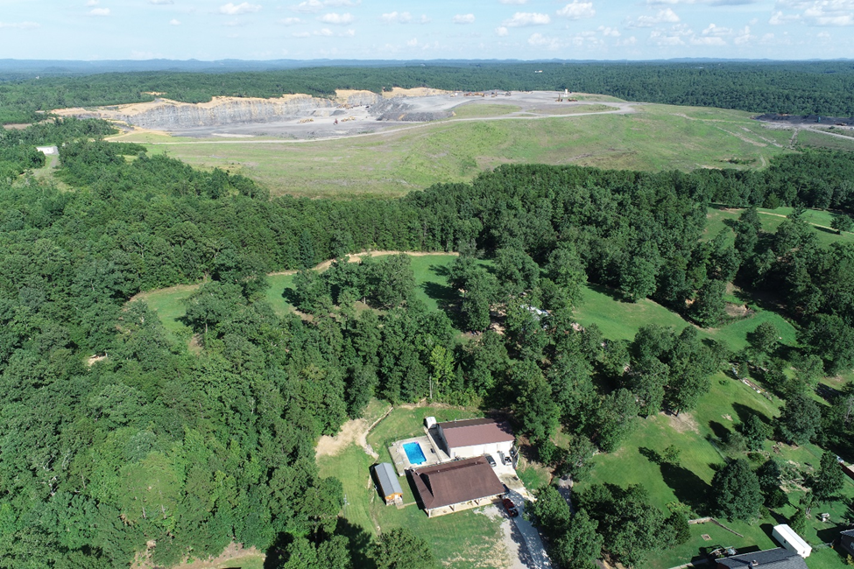
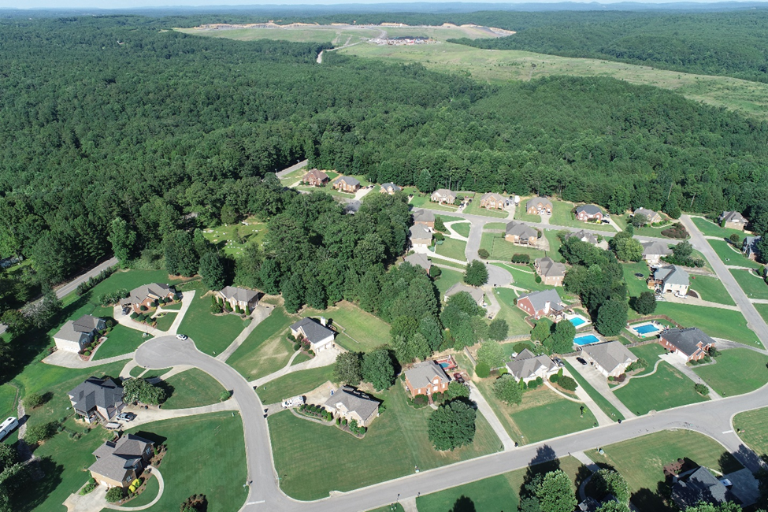
BLACK WARRIOR MINE, ALABAMA
Showing Proximity to Housing Subdivision
and Lack of Dust in Surrounding Environment

Slide 8
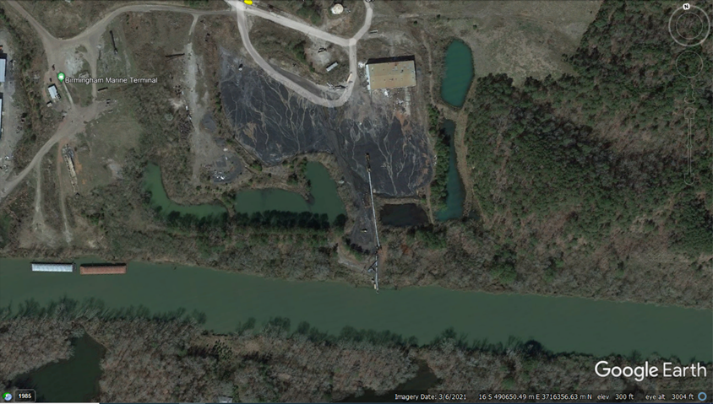
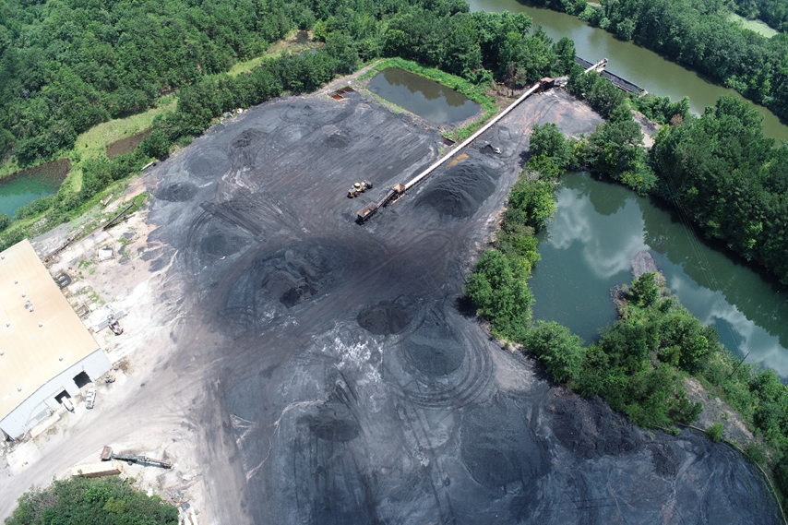
POWHATEN BARGE LOADOUT FACILITY, ALABAMA
500 K tonnes per year
Note proximity to watercourse, and that coal dust is confined to the coal stockpiles areas only

Slide 9
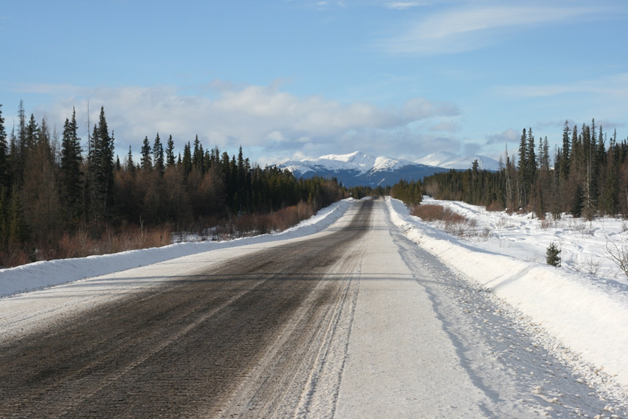
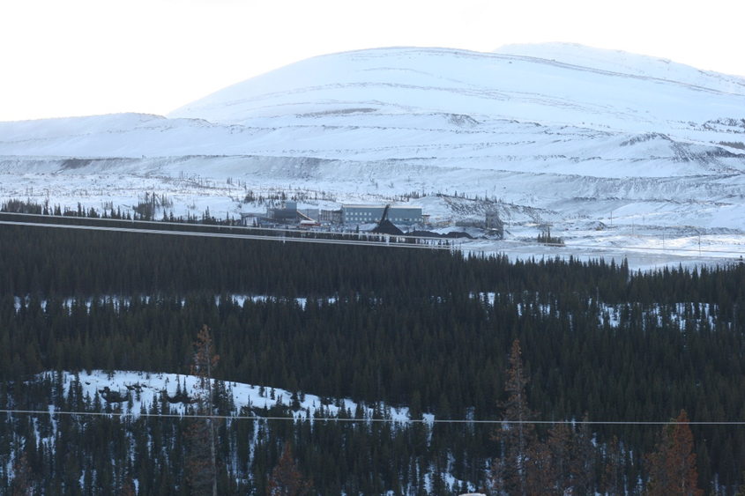
Trend Mine, Tumbler Ridge, BC
volume 1.5 million tonnes per year
Tenas Access Corridor Road will look similar to the Trend Mine Coal Haul Road in the Winter. Note the lack of coal dust on the road and surrounding landscape.
  Example of what Tenas Coal Processing Plant will look like in the winter from a distance. Note the lack of visible coal dust in the air and the landscape.

Slide 10
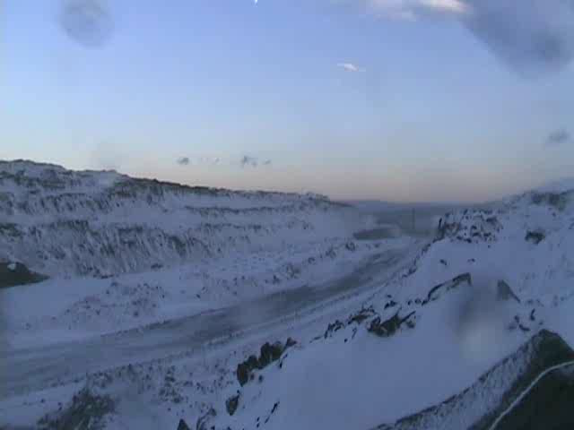
BLASTING – VIDEO 1
Scroll over image and press PLAY
Video shows blasting sequence and extent of dust plume

Slide 11
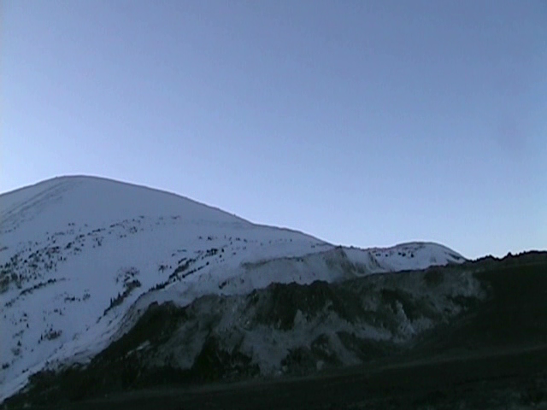
BLASTING – VIDEO 2
Scroll over image and press PLAY
Video shows blasting sequence from a distance
Video shows extent of dust plume caused by blasting

